Slide 1

Stroke Classification
Jordana Tepper, Troy Hendrickson, Viktoria Szontagh

Slide 2
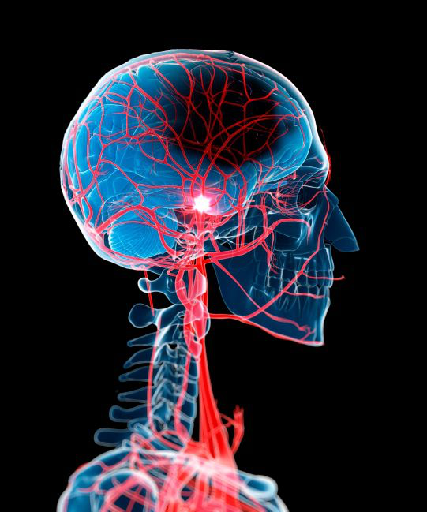
Agenda
1
BUSINESS UNDERSTANDING
2
DATA
3
BEST MODEL AND RESULTS
4
RECOMMENDATIONS
5
LIMITATIONS AND NEXT STEPS

Slide 3

Business Understanding
STAKEHOLDERS
The Mount Sinai Hospital in New York
THE PROBLEM
According to the World Health Organization (WHO) stroke is the 2nd leading cause of death globally, responsible for approximately 11% of total deaths. Additionally, in the US, someone has a stroke every 40 seconds.
On top of that, strokes are a known complication of surgery.
THE PROJECT
Develop a model that acts as a preliminary assessment to determine whether a person is likely to have a stroke or not during surgery using available data. The results will determine if further screening is needed.
THE GOAL
Introduce the model that arbitrates the best results to identify patients in need of extra screening before surgery

Slide 4
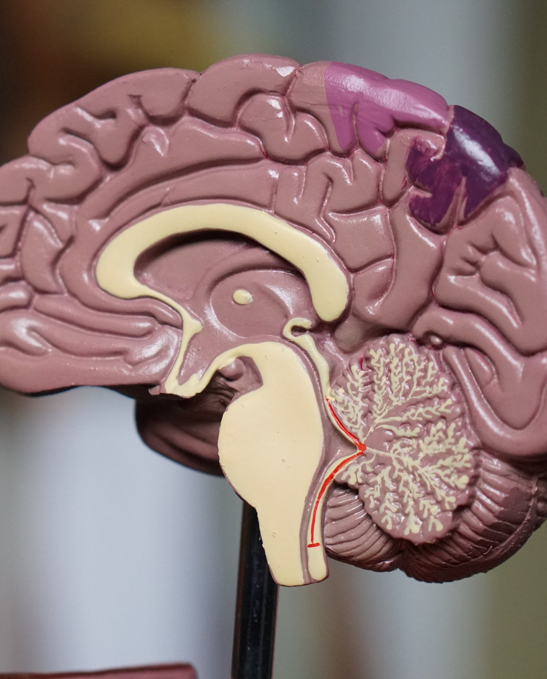
The Data
KAGGLE 'STROKE PREDICTION DATA SET'
FEATURES
BMI, Smoking Status, Glucose level, Age, Gender, Ever Married, Residence Type, Workin Status
5k+
ROWS
MISSING DATA
BMI (Body Mass Index)
11
IMBALANCE
COLUMNS
95% - No stroke
5% - Stroke

Slide 5
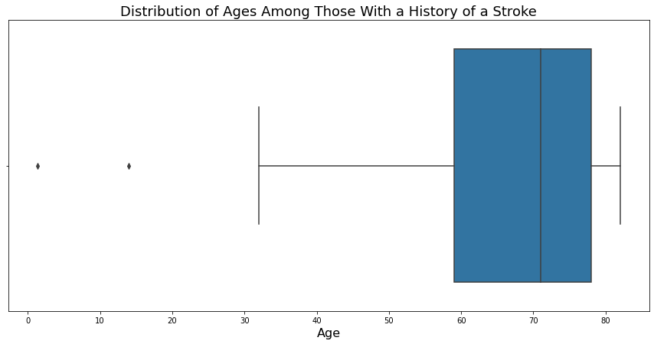
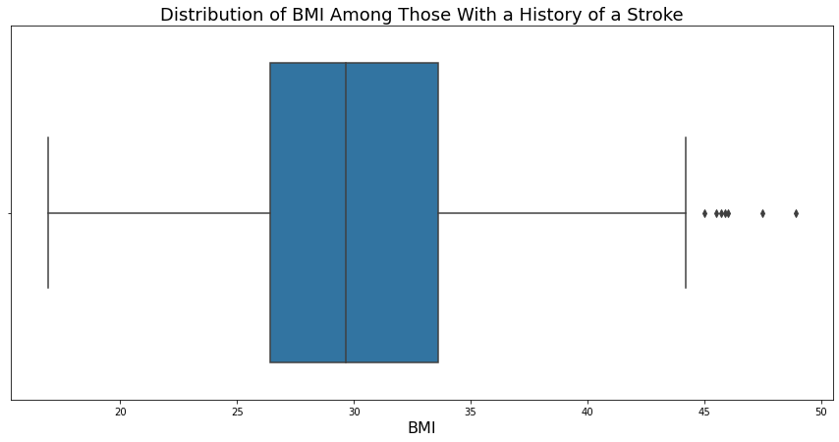
Data Processing

Slide 6
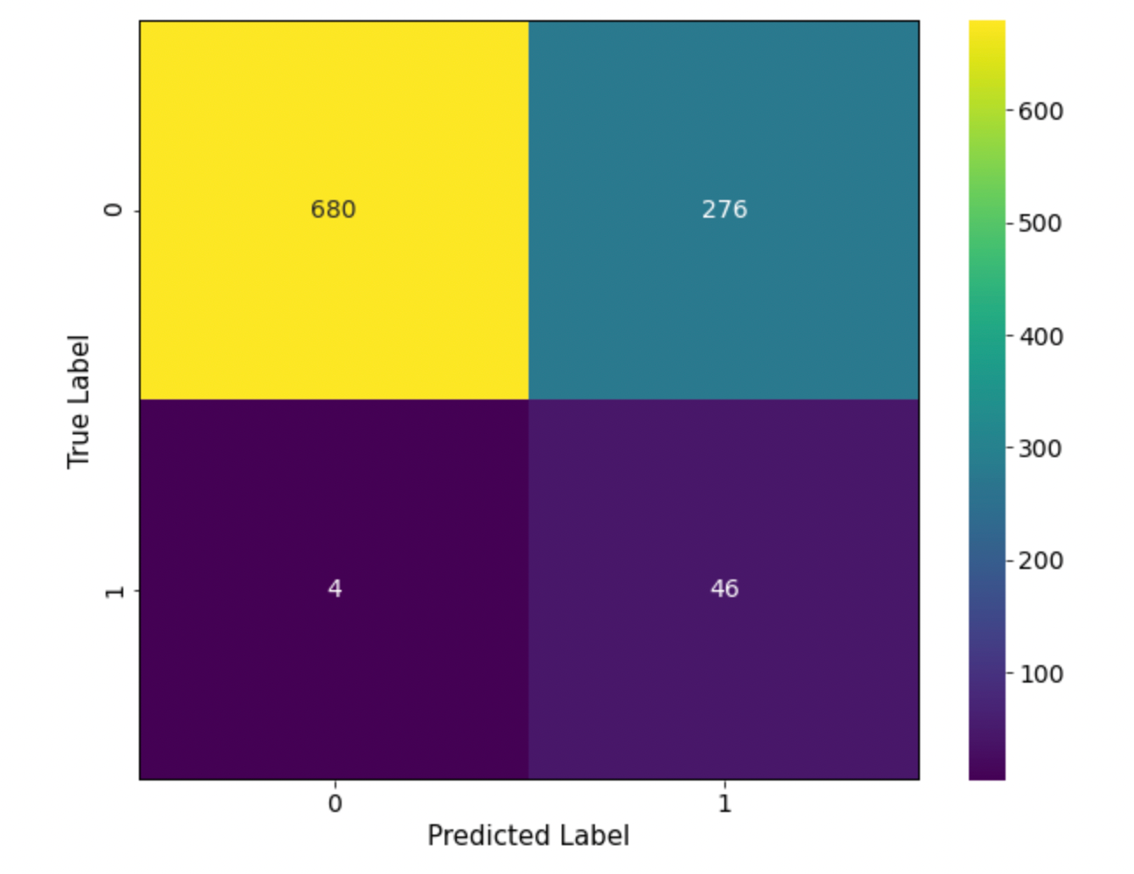
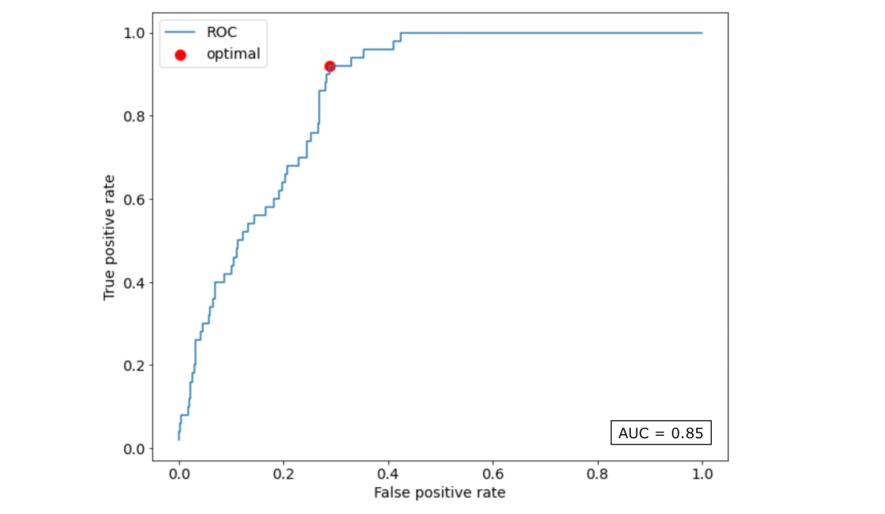
Best Model
Logistic Regression - Optimal Threshold (0.446)

Slide 7



CLASSIFICATION MODEL: LOGISTIC REGRESSION
Included optimal threshold for best results
RECALL SCORE: 92%
The main metric used to determine the accuracy of our model
A false negative is more costly than a false positive.
BETTER THAN BAYES?
Had best recall was our Gaussian Naive Bayes model with a recall score of 94% but a false positive rate of 0.60.

Slide 8

Recommendations
MODEL TYPE
Based on our project, we propose that logistic regression has the best classification of stroke risk and most effectively minimizes both the false negatives and false positives.
OPTIMIZE SCREENING COSTS
By decreasing the false positives, it gives less room to the insurance company to reject claims - benefiting both the patients and the hospital.

Slide 9
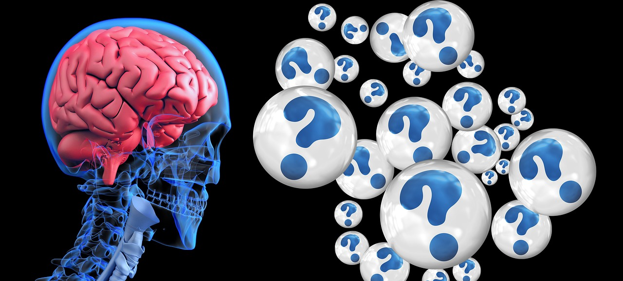
Limitations and Next Steps
Limitations
Medication is not taken into account
Missing Data
Unknown origin of the dataset
Next Steps
Cholesterol
Family history of stroke
Number of strokes
Race (i.e., the likelihood of stroke among different races)

Slide 10



Contact Us
TROY HENDRICKSON
JORDANA TEPPER
troyhendrickson@gmail.com
gitHub.com/tkhendrix22
linkedin.com/in/troy-hendrickson
jtepper724@gmail.com
gitHub.com/jordanete
linkedin.com/in/jordana--tepper
VIKTORIA SZONTAGH
vikkiszontagh@gmail.com
gitHub.com/vszontagh
linkedin.com/in/viktoriaszontagh

